Slide 1
COURSE OUTLINE
Introduction to Java
Encapsulation
Inheritance
Polymorphism
Classes
Objects
Java Basics
Data Types
Strings
Exceptions
Graphics
Multi threading
Inheritance

Slide 2
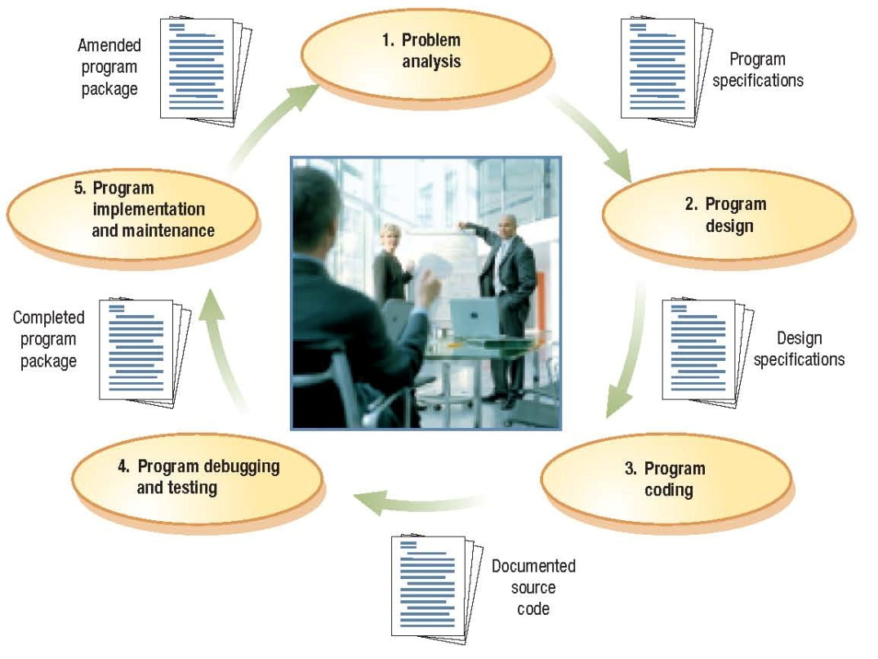
The Program Development Life Cycle (PDLC)
Program development: The process of creating application programs
Program development life cycle (PDLC

Slide 3
Approaches to Program Design and Development
Procedural programming: a program is separated into small modules that are called by the main program or another module when needed
Uses procedures (modules, subprograms): Smaller sections of code that perform specific tasks
Allows each procedure to be performed as many times as needed; (reusing)
Prior to procedural programming, programs were one large set of instructions (used GOTO statements)
Structured programming: Goes even further, breaking the program into small modules (Top-down design)

Slide 4
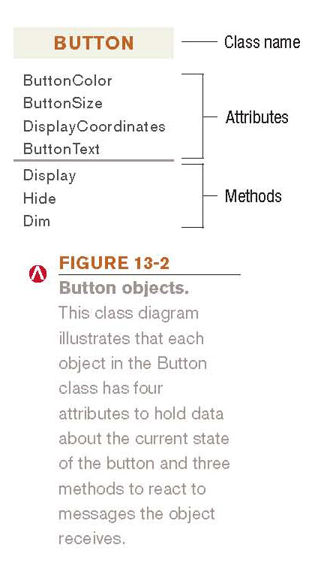
Approaches to Program Design and Development
Object-oriented programming (OOP): Programs consist of a collection of objects that contain data and methods to be used with that data
Class: Group of objects that share some common properties
Instance: An individual object in a class
Attributes: Data about the state of an object
Methods: Perform actions on an object
Objects can be used by more than
one program

Slide 5
OBJECT ORIENTED PROGRAMMING
Object Oriented programming (OOP) is a programming paradigm (pattern) that relies on the concept of classes and objects.
OOP focuses on the objects that developers want to manipulate rather than the logic required to manipulate them. This is well-suited for programs that are large, complex and actively updated or maintained

Slide 6
What is the structure(building Blocks) of OOP?
Classes
Objects
Methods are functions that are defined inside a class to describe the behaviors of an object.
Attributes represent the state of an object.

Slide 7
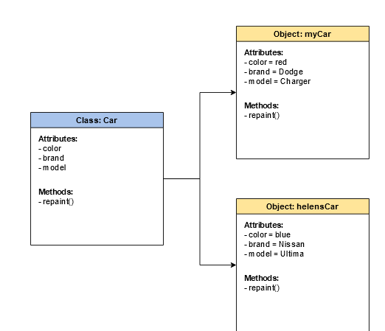
Class Vs Object
Classes are user defined data types and are blueprints for individual objects
Objects are instances of a class created with specifically defined data

Slide 8
Objects
Real-world objects have attributes and behaviors.
Examples:
Dog
Attributes: breed, color, hungry, tired, etc.
Behaviors: eating, sleeping, etc.
Bank Account
Attributes: account number, owner, balance
Behaviors: withdraw, deposit

Slide 9
Analyze this
A simple example would be a class representing a person. The person class would contain attributes to represent information such as the person’s age, name, height, etc. The class definition might also contain functions such as "sayMyName" which would simply print that person’s name to the screen.
A family could be constructed by instantiating person objects from the class for each member of the family. Each person object would contain different data attributes since each person is unique.

Slide 10
Principles of OOP
The four pillars of object oriented programming are:
Inheritance
Encapsulation
Abstraction
Polymorphism

Slide 11
Inheritance
Inheritance allows classes to inherit features of other classes. Put another way, parent classes extend attributes and behaviors to child classes. Inheritance supports reusability.
If basic attributes and behaviors are defined in a parent class, child classes can be created extending the functionality of the parent class, and adding additional attributes and behaviors.

Slide 12
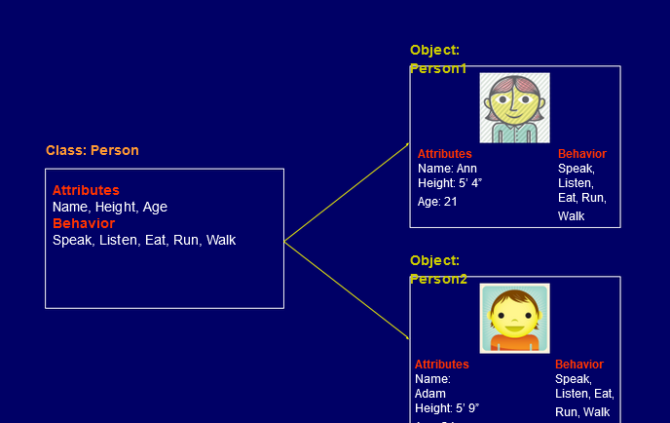
Inheritance

Slide 13
Encapsulation
Keep important information inside an object, and only expose selected information to the outside world.
Encapsulation requires defining some fields as private and some as public.
Private/ Internal interface: methods and properties, accessible from other methods of the same class.
Public / External Interface: methods and properties, accessible also from outside the class.
Encapsulation adds security

Slide 14
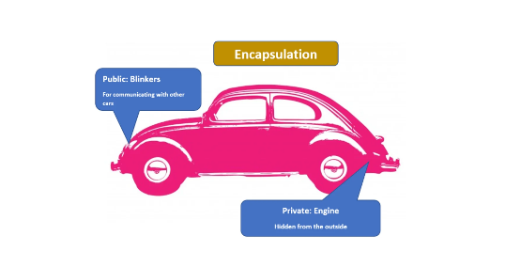
Encapsulation
Let’s use a car as a metaphor for encapsulation. The information the car shares with the outside world, using blinkers to indicate turns, are public interfaces. In contrast, the engine is hidden under the hood.
It’s a private, internal interface. When you’re driving a car down the road, other drivers require information to make decisions, like whether you’re turning left or right. However, exposing internal, private data like the engine temperature, would just confuse other drivers

Slide 15
Abstraction
Abstraction is using simple classes to represent complexity. Abstraction is an extension of encapsulation. For example, you don’t have to know all the details of how the engine works to drive a car.
Abstraction means that the user interacts with only selected attributes and methods of an object.

Slide 16
The benefits of abstraction
Simple, high level user interfaces
Complex code is hidden
Security
Easier software maintenance
Code updates rarely change abstraction

Slide 17
Polymorphism
Polymorphism means designing objects to share behaviors. Using inheritance, objects can override shared parent behaviors, with specific child behaviors.
Polymorphism allows the same method to execute different behaviors in two ways:
method overriding
method overloading.

Slide 18
Polymorphism
Suppose we have a class called, “Animal” and two child classes, “Cat,” and “Dog.” If the Animal class has a method to make a noise, called, “makeNoise,” then, we can override the "makeNoise" function that is inherited by the sub-classes, "Cat" and "Dog," to be “meow” and “bark,” respectively

Slide 19
Benefits of Polymorphism are
Method overriding
Method overloading

Slide 20
Approaches to Program Design and Development
Read about
Structured Programming
Aspect-oriented programming (AOP)
RAD (rapid application development) and extreme programming (XP)
Agile software development
Differences between Structured Programming and OOP

Slide 21
Unified Modelling Language
UML is a diagramming tool for describing and documenting object oriented applications
Generally two main diagrams of UML are used regularly
Class diagrams
Sequence diagrams
Notes:
The reason I’m introducing a few UML basics is because it makes talking about applications much easier, as we can produce a diagram describing the classes and their relationships, rather than just jumping into the code.
It’s also a useful skill in its own right, and is generally encountered in OO design documents.

Slide 22
Unified Modelling Language
Class Diagrams
Describe classes and interfaces
…their properties
…their public interface
…and their relationships (e.g. inheritance, aggregation)
Sequence Diagrams
Describe how objects send messages to one another
Useful for describing how a particular part of an application works
We’ll be covering just class diagrams
Very useful for discussing OO applications

Slide 23
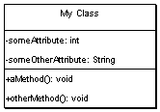
UML -- Classes
Box with 3 sections
The top contains the class name
The middle lists the classes attributes
The bottom lists the classes methods
Can indicate parameters and return types to methods, as well as their visibility

Slide 24
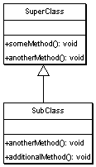
UML -- Inheritance
Inheritance is shown by a solid arrow from the sub-class to the super-class
The sub-class doesn’t list its super-class attributes or methods,
unless its providing its own alternate version (I.e. is extending the behaviour of the base class)

Slide 25
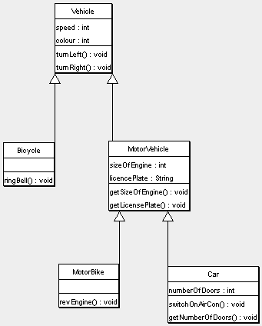
Example #1

